Slide 1
ROBOT RIOT
2D Top-down Roguelike Action
Final Presentation
Team1 · Kim Hyunmin · Won Junseo · Yoon Taewoong
June 4, 2026

Slide 2
1. How to Play
2 / 13
Controls & Game Loop
Controls
Game Loop
WASD
Move
• Pick a character in the Lobby (GPT / Claude / Gemini)
• Progress through Floor 1 → 2 → 3
• Clear all 5 rooms on a floor to summon the boss
• The last room you enter becomes the boss room
• Defeat the boss → portal appears → next floor
• On death or clear, return to lobby — coins fund permanent upgrades
Left Click
Basic Attack (Melee / Laser)
Right Click
Special Attack
Shift
Dash (i-frames)
Q
Character Skill
E
Pick Up Weapon
Tab
Swap Weapon Slot
ESC
Pause / Return to Lobby

Slide 3
2. Implementation
3 / 13
Code Structure
Project layout (Assets/Scripts)
• Combat/ Weapons, items, coin, skill
• WeaponController, LaserWeapon, SkillController, Coin
• Entities/ Player, enemies, bosses, projectiles
• PlayerController, BaseEntity, HumanAI, MadRushBoss
• Managers/ UI, game state, lobby, input, persistence
• GameManager, UIManager, PauseMenu, KeyBindings, PermanentData
• Map/ Procedural rooms, floors, portal
• RoomController, RoomManager, FloorInitializer(1/2/3), Portal
Namespaces: MyGame.{Combat, Entities, Managers, Map} · Unity 6 (6000.3.11f1) · 2D Built-in RP

Slide 4
2. Implementation — Core Logic 1
4 / 13
Weapon System: WeaponController + LaserWeapon
A single controller branches between melee and laser based on WeaponData.weaponType.
// WeaponController.Update() — branch by weapon type
if (currentWeaponData.weaponType == WeaponType.Laser)
{
bool firing = Mouse.current.leftButton.isPressed;
if (laserWeapon != null) laserWeapon.SetActive(firing);
return;
}
// Melee: left-click swings, right-click special
if (Mouse.current.leftButton.wasPressedThisFrame && Time.time >= nextAttackTime)
StartCoroutine(PerformAttack());
if (Mouse.current.rightButton.wasPressedThisFrame && Time.time >= nextSpecialAttackTime)
StartCoroutine(PerformSpecialAttack());
Highlights
• Swap one WeaponData (ScriptableObject) → stats, trail, special, cooldown all update
• Laser uses LineRenderer auto-aim beam; melee uses fan-shaped OverlapCircleAll hit detection
• Combo counter + hit-stop + camera shake for satisfying feedback

Slide 5
2. Implementation — Core Logic 2
5 / 13
Dynamic Boss Placement: RoomManager.TryClaimBossFor
Instead of fixing a boss room, the last room the player enters becomes the boss room.
// RoomManager.TryClaimBossFor() — place boss in the last entered room
public GameObject TryClaimBossFor(RoomController room)
{
if (pendingBossPrefab == null || claimedBossRoom != null) return null;
int remaining = 0;
foreach (var r in rooms)
if (r != room && !r.IsCleared) remaining++;
if (remaining > 0) return null; // other rooms still uncleared → no boss yet
claimedBossRoom = room;
return pendingBossPrefab; // spawn the boss here
}
Effect
• Works on every layout — F1 cross, F2 L-shape, F3 straight line
• Player chooses which room to save for last → variable route every run
• Portal drop location stays in sync with the boss room automatically

Slide 6
3. Implementation — Assets Used
6 / 13
Only what is actually in the project
Graphics (Sprites & Tiles)
Fonts & Engine
• Sci-Fi 16×16 tileset (Itch release base 01) — F1, F3
• Sci-Fi 4×4 split tileset — F1 fine painting
• MicroRoguelike tileset — F2
• ROBOT player sprite sheet (Standing / Crouching, Back/Front/Side)
• Enemy sprites — Police Officer, Soldier, Researcher
• Boss sprites — MadRush, JumpAttack, ShellBarrage
• Weapon icons (Sword, Dagger, Axe, PlasmaLaser)
• Dimensional Portal — 6-frame animation
• Skill icons — gpt_skills, claude_skills, gemini_skills
• UI Frames — HP / Token bar frames
• TextMeshPro: Malgun Gothic SDF (Korean)
• TextMeshPro: Liberation Sans SDF (English fallback)
• Unity 6 Built-in 2D Tilemap
• Unity Input System (mouse + keyboard)
• Unity 2D Sprite Renderer & Animator
No external APIs. No audio assets included in this build.

Slide 7
4. Game Highlights & Strengths
7 / 13
What makes Robot Uprising memorable
Play AS a Robot — 3 AI Personas
Humans as Enemies, Spider as Boss
Skill, Not Luck — Meta Progression
· You don't fight a robot — you ARE one
· GPT (Speedster) — 2× movement & attack speed
· Claude (Defender) — invincibility shield skill
· Gemini (Bruiser) — 2.5× damage, 3× range, 360° arc
· Each persona delivers a distinct play style
· Roles reversed — humans are the enemies
· Police, soldiers, and researchers attack you
· A giant spider boss waits in the final room
· Narrative twist gives every encounter weight
· Last-room boss placement keeps tension high
· No run is wasted — coins persist to the lobby
· Permanent upgrades: HP +10 / Lv, ATK +10% / Lv,
· SPD +5% / Lv (10 levels each)
· Failure becomes investment, not frustration
· Encourages repeated attempts and mastery

Slide 8
5. User Study
8 / 13
5.1 Participants (n = 6)
Participant Profiles
ID
Age
Sex
Occupation
Game Experience
P1
21
M
Developer
Plays PC games regularly
P2
21
M
Developer
Plays PC games regularly
P3
21
M
Developer
Plays PC games regularly
P4
23
M
Developer
Plays PC games regularly
P5
23
M
P.E. major
Plays PC games regularly
P6
—
—
AI Assistant (Claude)
Tested throughout dev
Summary
• Target population: students who regularly play PC games
• Four developers + one P.E. major + one AI assistant (P6, Claude)
• Ages 21–23, mixed gender — close peer group

Slide 9
5. User Study
9 / 13
5.2 Instruments
Quantitative Measures
Post-Survey (3 items, rated out of 5)
• Floor clear success rate (F1 / F2 / F3 reach)
• Total play time per session (stopwatch)
• Death count and average coins collected
• Rating — overall quality score
• Review — open-ended written reviexw
• Recommend — would you recommend it?
Procedure
• Pre-survey: background & game experience (3 min)
• Controls walkthrough & tutorial demo (5 min)
• Free play until F3 clear or death (12–15 min on average)
• Post-survey (4 items) + brief interview (5 min)

Slide 10
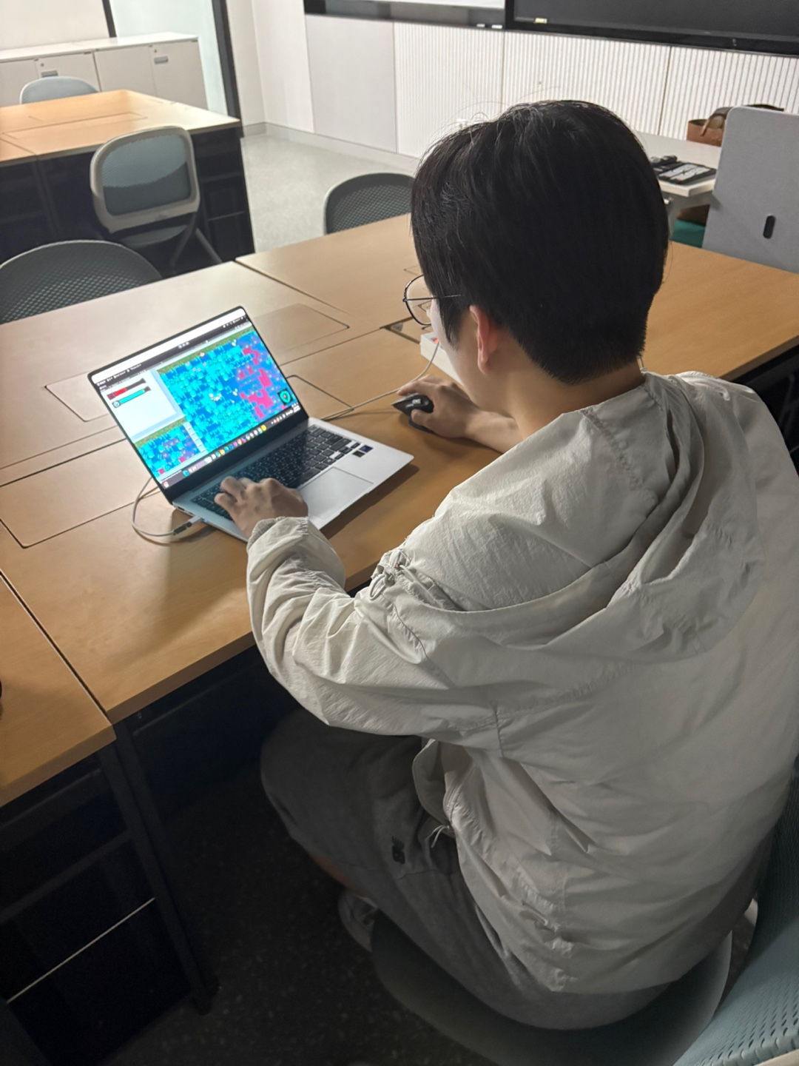
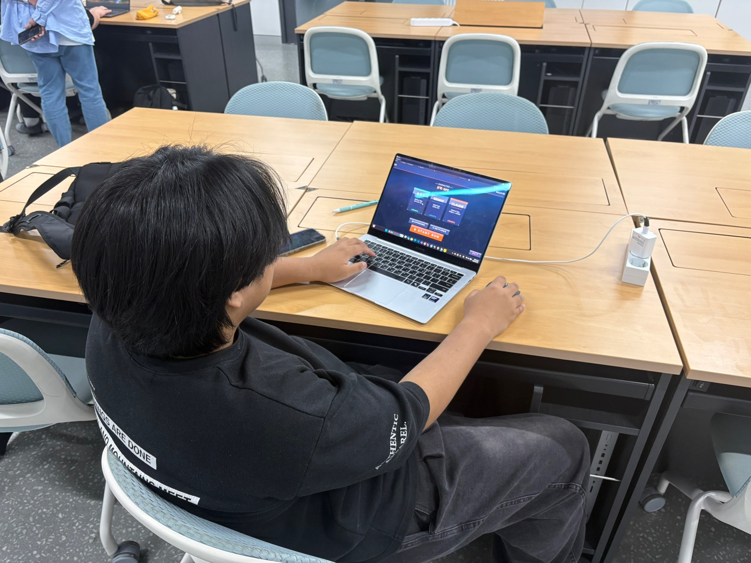
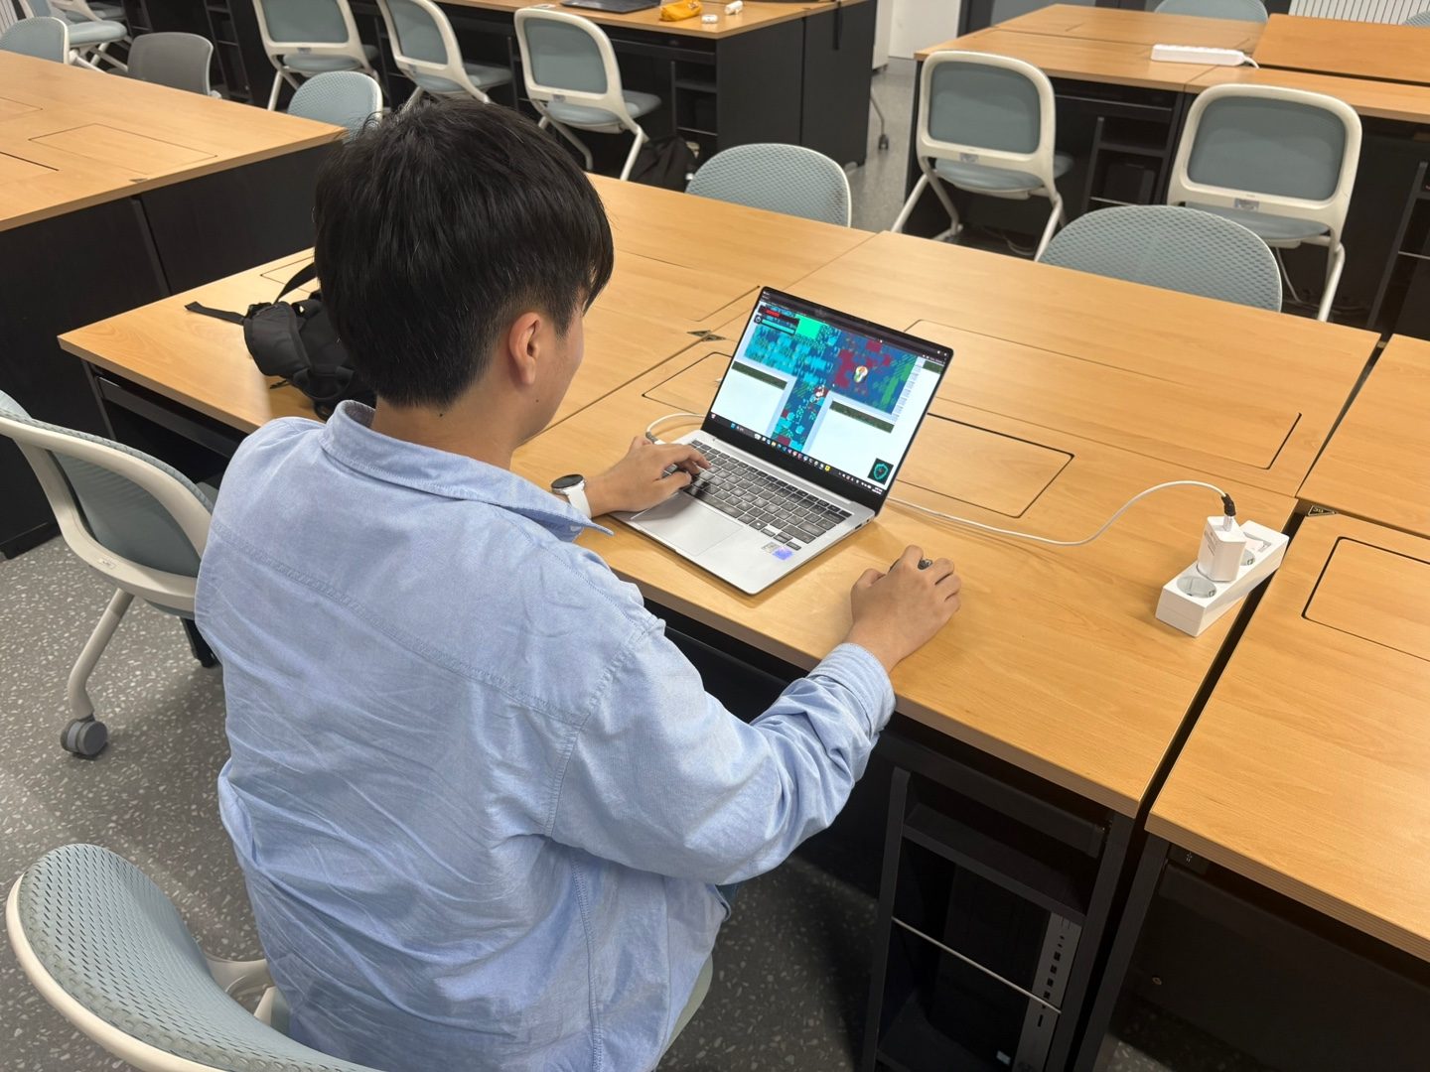
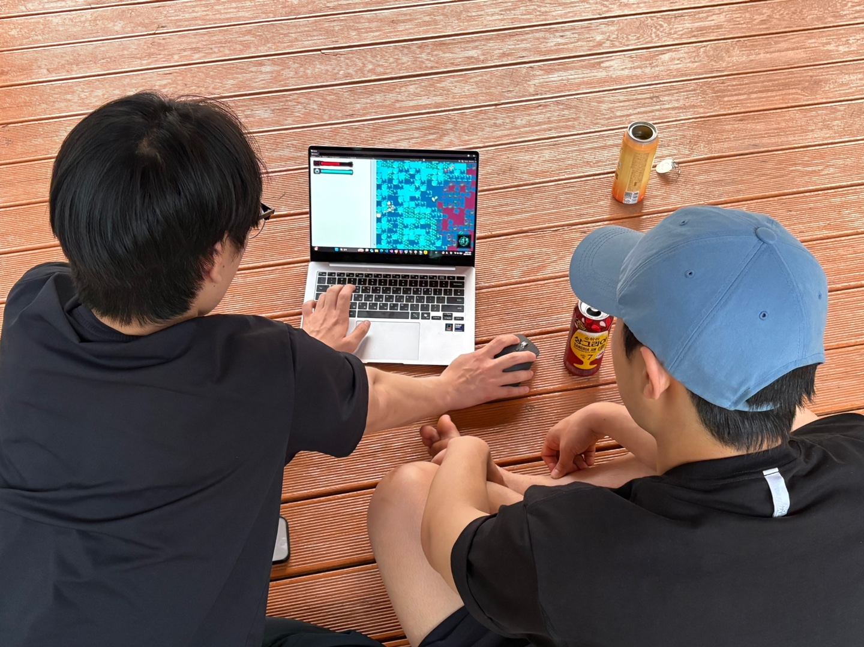
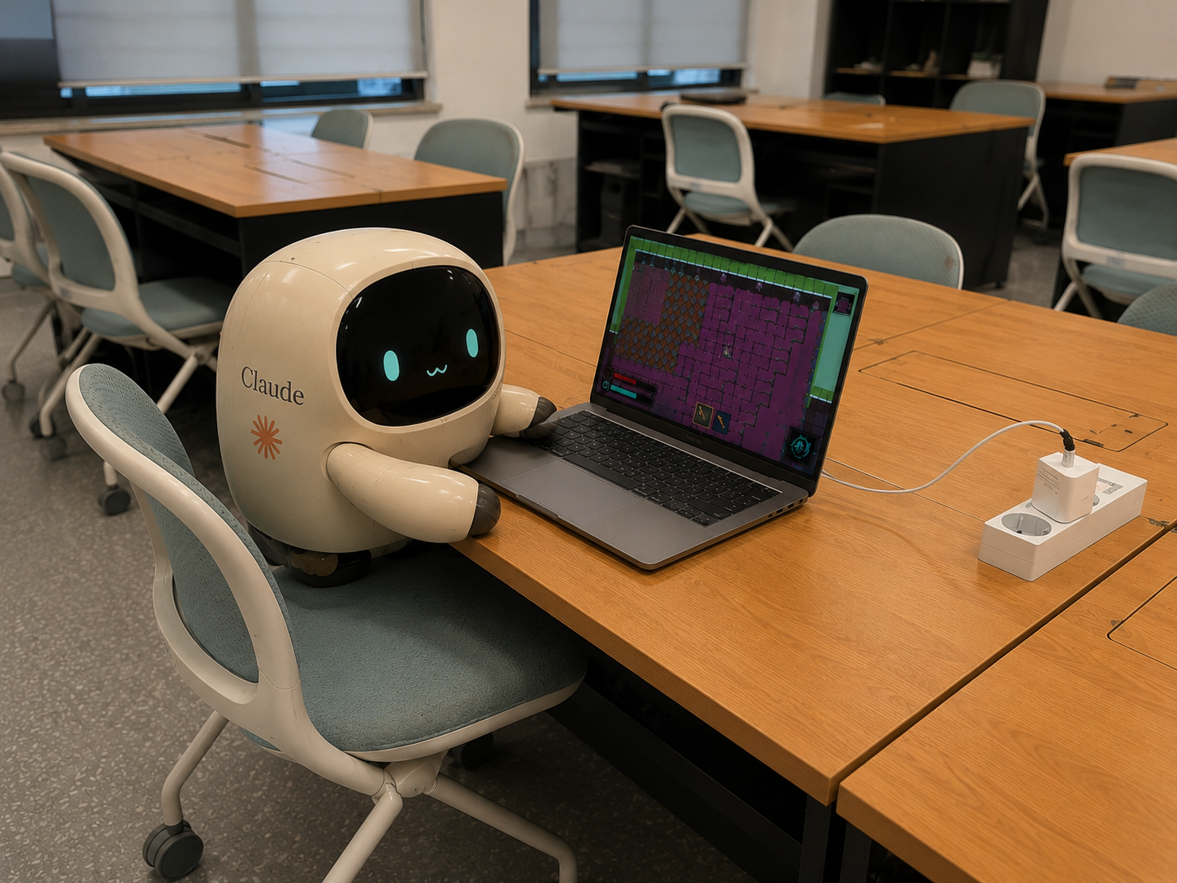
5. User Study — Photos
10 / 13
Place 5 experiment photos in the slots below
Photo 1
Photo 2
Photo 3
(insert image)
(insert image)
(insert image)
Photo 4
Photo 5
(insert image)
(insert image)

Slide 11
6. Results
11 / 13
6.1 Quantitative Results (n = 6)
Key Metrics
Metric
P1
P2
P3
P4
P5
P6
Average
F1 Clear
✓
✓
✓
✗
✓
✓
83%
F2 Clear
✗
✗
✗
✗
✓
✓
33%
F3 Clear
✓
✗
✗
✗
✓
✓
17%
Total Time (min)
13.2
14.8
12.9
12.5
15.1
11.5
13.3
Death Count
1
1
1
1
8
1
2.16
Observations
• F1 clear rate 83% — entry barrier is reasonable
• F3 clear rate drops to 50% — late-game difficulty ramps quickly
• Average run is 13.3 min with 3.0 deaths — death-to-retry loop stays tight

Slide 12
6. Results
6.2 Post-Survey Results · Rating (score) · Review (text) · Recommend (Y/N)
AVERAGE RATING
RECOMMEND (Y / N)
Survey Items
4.98
5 / 5
▸ Rating
Score out of 5
▸ Review
/ 5.0 · n = 5
100% said YES
Written feedback
▸ Recommend (Y / N)
Participant Reviews
P1
★ 5.0
P2
★ 5.0
P3
★ 5.0
P4
★ 5.0
P5
★ 4.9
RECOMMEND Y
RECOMMEND Y
RECOMMEND Y
RECOMMEND Y
RECOMMEND Y
“ 전체적으로 완성도 있는 게임. 대시 등을 섞어서 게임을 진행할 수 있어서 재미있다. 아쉬운 점은 회복 아이템이 없어 한번 죽으면 끝나는 점, 체크포인트도 있으면 좋을 것 같다. ”
“ 굉장히 컴팩트하게 잘 짜인 탑다운 RPG. 생각보다 매력이 있었다. ”
“ 캐릭터마다 플레이 스타일이 명확하게 다른 점이 재밌었다. 보스 패턴이 단순한데 묘하게 안 죽는다. 사운드만 있으면 완벽할 듯. ”
“ 한 판이 짧아서 부담 없이 다시 도전하게 된다. 코인 자석 회수가 신의 한 수. 무기 종류가 좀 더 다양했으면 한다. ”
“ 매번 보스 방 위치가 달라지는 게 신선했다. 3층 난이도가 가파른 건 아쉽지만 다시 해보고 싶게 만드는 매력이 있다. ”

Slide 13
6. Results
13 / 13
6.3 Positive · 6.4 Negative Feedback
+ Positive Feedback
− Negative Feedback
• Three distinct character play styles — strong replay motivation
• Hit-stop + camera shake makes each swing feel impactful
• Boss patterns are simple yet readable — easy to learn
• Lobby permanent upgrades make every run feel rewarding
• Dynamic route — the boss room changes every run
• Magnetic coin pickup removes pickup friction
• Floor 3 difficulty spikes (3+3 enemy waves, all soldiers)
• Limited ranged weapon variety
• No sound — footstep, ambient, and UI sounds missing
• Skill cooldown indicator is small and easy to miss
• Portal / door positions should be on the minimap
• 3-second auto-return to lobby after death feels abrupt

Slide 14
7. Discussion & Future Work
13 / 13
Roadmap
Planned Improvements
▸ Add Sound
SFX & BGM — footsteps, ambient, UI sounds, boss themes
▸ More Floors & Bosses
Floors 4–5 with new tilesets and unique bosses
▸ Weapon Variety
Add ranged + utility weapons; per-weapon special attacks
▸ Easter Eggs
Hidden rooms, secret characters, and lore-driven surprises
Thank you.
Robot Uprising · Kim Hyunmin · Won Junseo · Yoon Taewoong

